Slide 1
Market Churn
Team Member:

Slide 2
1
Define the Issue
2
Data Preparation
3
Modeling
Model 1: Naïve Bayes
Model 2: Random Forrest
Model 3: KNN
Model Evaluation and Comparison
4
Conclusion

Slide 3

Background
Roz
the telecom company would like to know in advance which customers would churn in near future
help this company in characterizing customer churn

Slide 4
1
Define the Issue
2
Data Preparation
3
Modeling
Model 1: Naïve Bayes
Model 2: Random Forrest
Model 3: KNN
Model Evaluation and Comparison
4
Conclusion

Slide 5
Data
Roz
Xx metrics,
Churn is the predicted value
No null values
Category | Metric | Data Type
 | State
 | Account Length
 | Area Code
 | Phone Number
 | Inter Plan
 | VoiceMail Plan
 | No of Vmail Mesgs
 | No of Calls Customer Service
 | Churn
 | Total Day Min
 | Total Day Calls
 | Total Day Charge
 | Total Evening Min
 | Total Evening Calls
 | Total Evening Charge
 | Total Night Min
 | Total Night Calls
 | Total Night Charge
 | Total Int Min
 | Total Int Calls
 | Total Int Charge

Slide 6
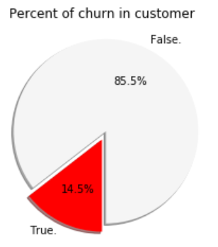
Finding more about Churn
Roz

Slide 7
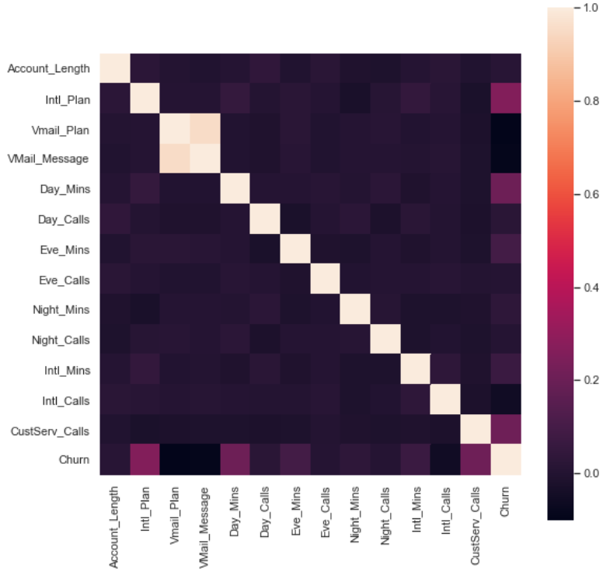
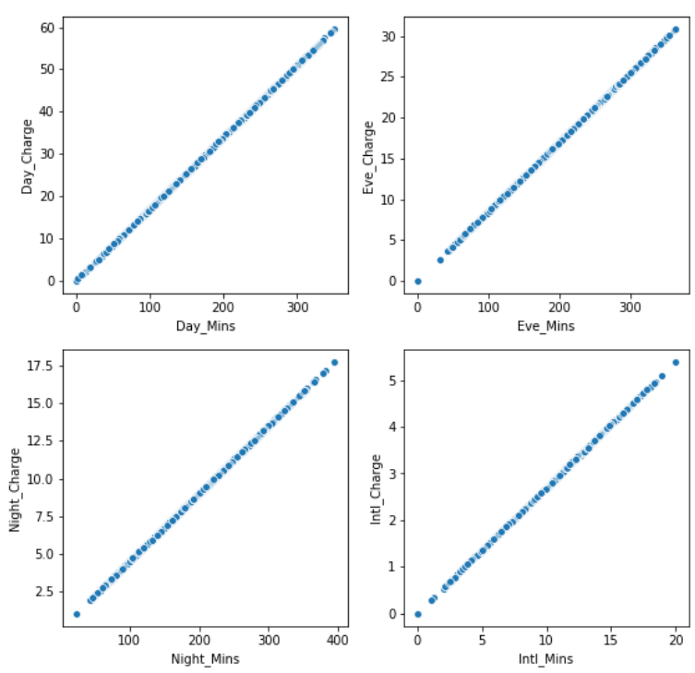
Correlation
Grace

Slide 8
Variable Dropped
Grace

Slide 9
Variable Dropped (Cont.)
Grace

Slide 10
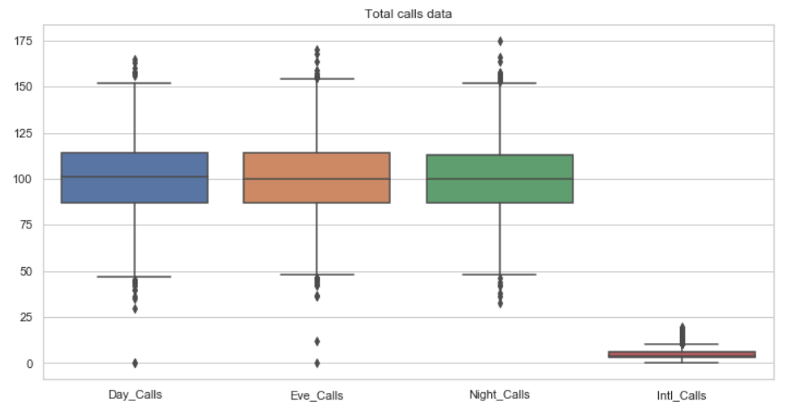
Outlier
Shub

Slide 11
Additional Metrics
Shub

Slide 12
Final Metrics in the Model
Shub
Correlation

Slide 13
1
Define the Issue
2
Data Preparation
3
Modeling
Model 1: Naïve Bayes
Model 2: Random Forrest
Model 3: KNN
Model Evaluation and Comparison
4
Conclusion

Slide 14

Measuring Metric Chosen
Sumithra
 | Descrpiton | Pro/Cons
Accuracy

Slide 15
1
Define the Issue
2
Data Preparation
3
Modeling
Model 1: Naïve Bayes
Model 2: Random Forrest
Model 3: KNN
Model Evaluation and Comparison
4
Conclusion

Slide 16
Model 1: Naïve Bayes
Sumithra
Method :xxx
Pros and cons
Results: xxx
Model Comparison
(if you run multiple models, the comparison)

Slide 17
Model 2: Random Forrest
Shub
Method :xxx
Results: xxx
Model Comparison

Slide 18
Model 3: KNN
Grace
Method :xxx
Results: xxx
Model Comparison

Slide 19
1
Define the Issue
2
Data Preparation
3
Modeling
Model 1: Naïve Bayes
Model 2: Random Forrest
Model 3: KNN
Model Evaluation and Comparison
4
Conclusion

Slide 20
Model Comparison
Grace
 | Evaluation | Test | Model Chosen
Model 1: Naïve Bayes
Model 2: Random Forrest
Model 3: KNN

Slide 21
1
Define the Issue
2
Data Preparation
3
Modeling
Model 1: Naïve Bayes
Model 2: Random Forrest
Model 3: KNN
Model Evaluation and Comparison
4
Conclusion

Slide 22
Feature Importance
Sumithra

Slide 23
Conclusion
Roz

Slide 24
Q & A
Thank you!

Slide 25
Appendix

Slide 26
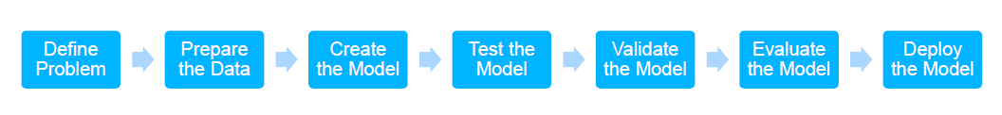

Slide 27
Part 1:
Data feature
Mean, max….
Smote
Rose
Baseline
Choose metrics for measure: why, which is which
Number of test accuracy, evaluation accuracy → model generalized
Use the pip chart to present
Grid search

Slide 28
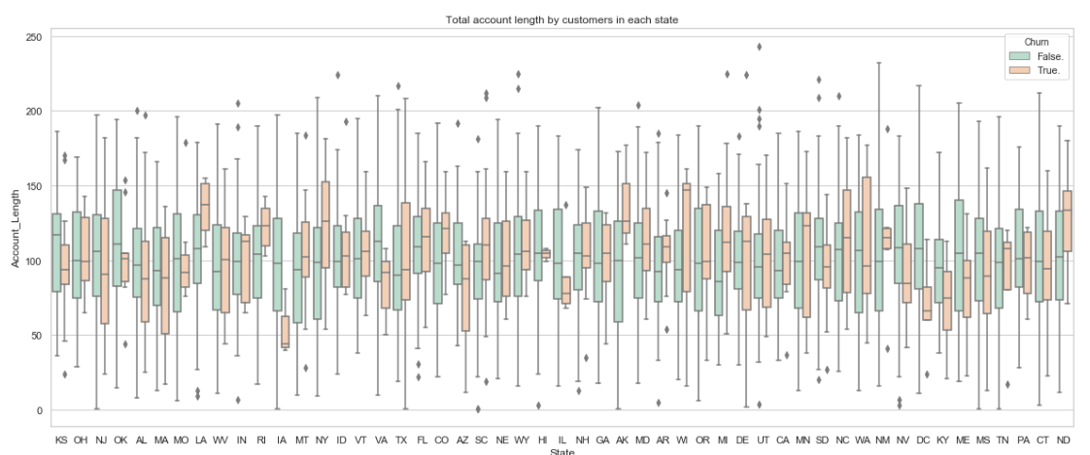
Recall: imbalanced dataset, important, had and predict correctly

